Slide 1
For those who did not get a chance to join us online Tuesday, July 11 or Wednesday, July 12, below are the recordings for both days.
Tuesday, July 11 Recording
https://uh-edu-cougarnet.zoom.us/rec/share/tKthvmXNSOh1YoGwUnzyVC3wCrgWmmTVS2Xdt6juReBTZWtumsn1WXDzFT1VXNYt.mWyCDj867CoFndMH
Passcode: +.ci8%F#
Wednesday, July 12
https://uh-edu-cougarnet.zoom.us/rec/share/te9rv6kG1MqCtWyPxacvp2h0ekCj9tTVVRrqfpyfTIsHHb8BCiR-c6-iHFvlNisi.5RXqe8CBUdHW6OJY
Passcode: 6UBFR&Kf

Slide 2

BUSI 1301 – Business Principles in a Global Economy
Professor: Dr. Joseph L Thompson

Slide 3
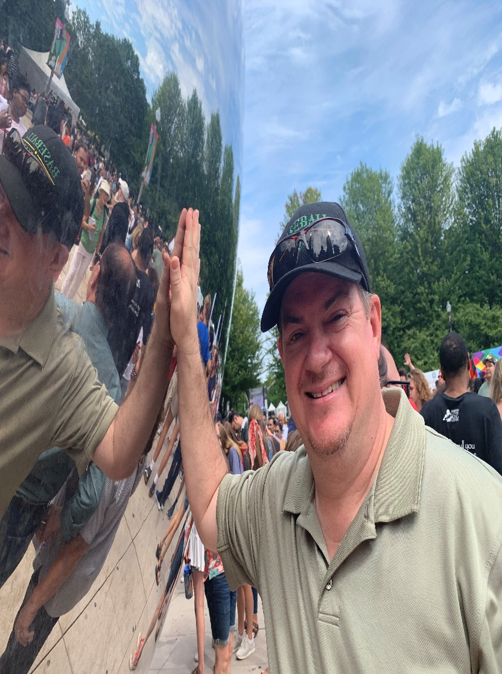
Semester Contact Information for Professor Thompson
Professor: Dr. Joseph L Thompson
Preferred Emails:
jlthompson@bauer.uh.edu
drjoethompsonuh@gmail.com
Office Location:
325P MH (Melcher Hall)
Office Hours:
1130-1230 M
12-1 PM Tue

Slide 4












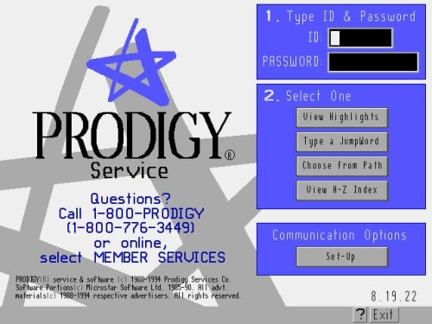


Slide 5





Slide 6
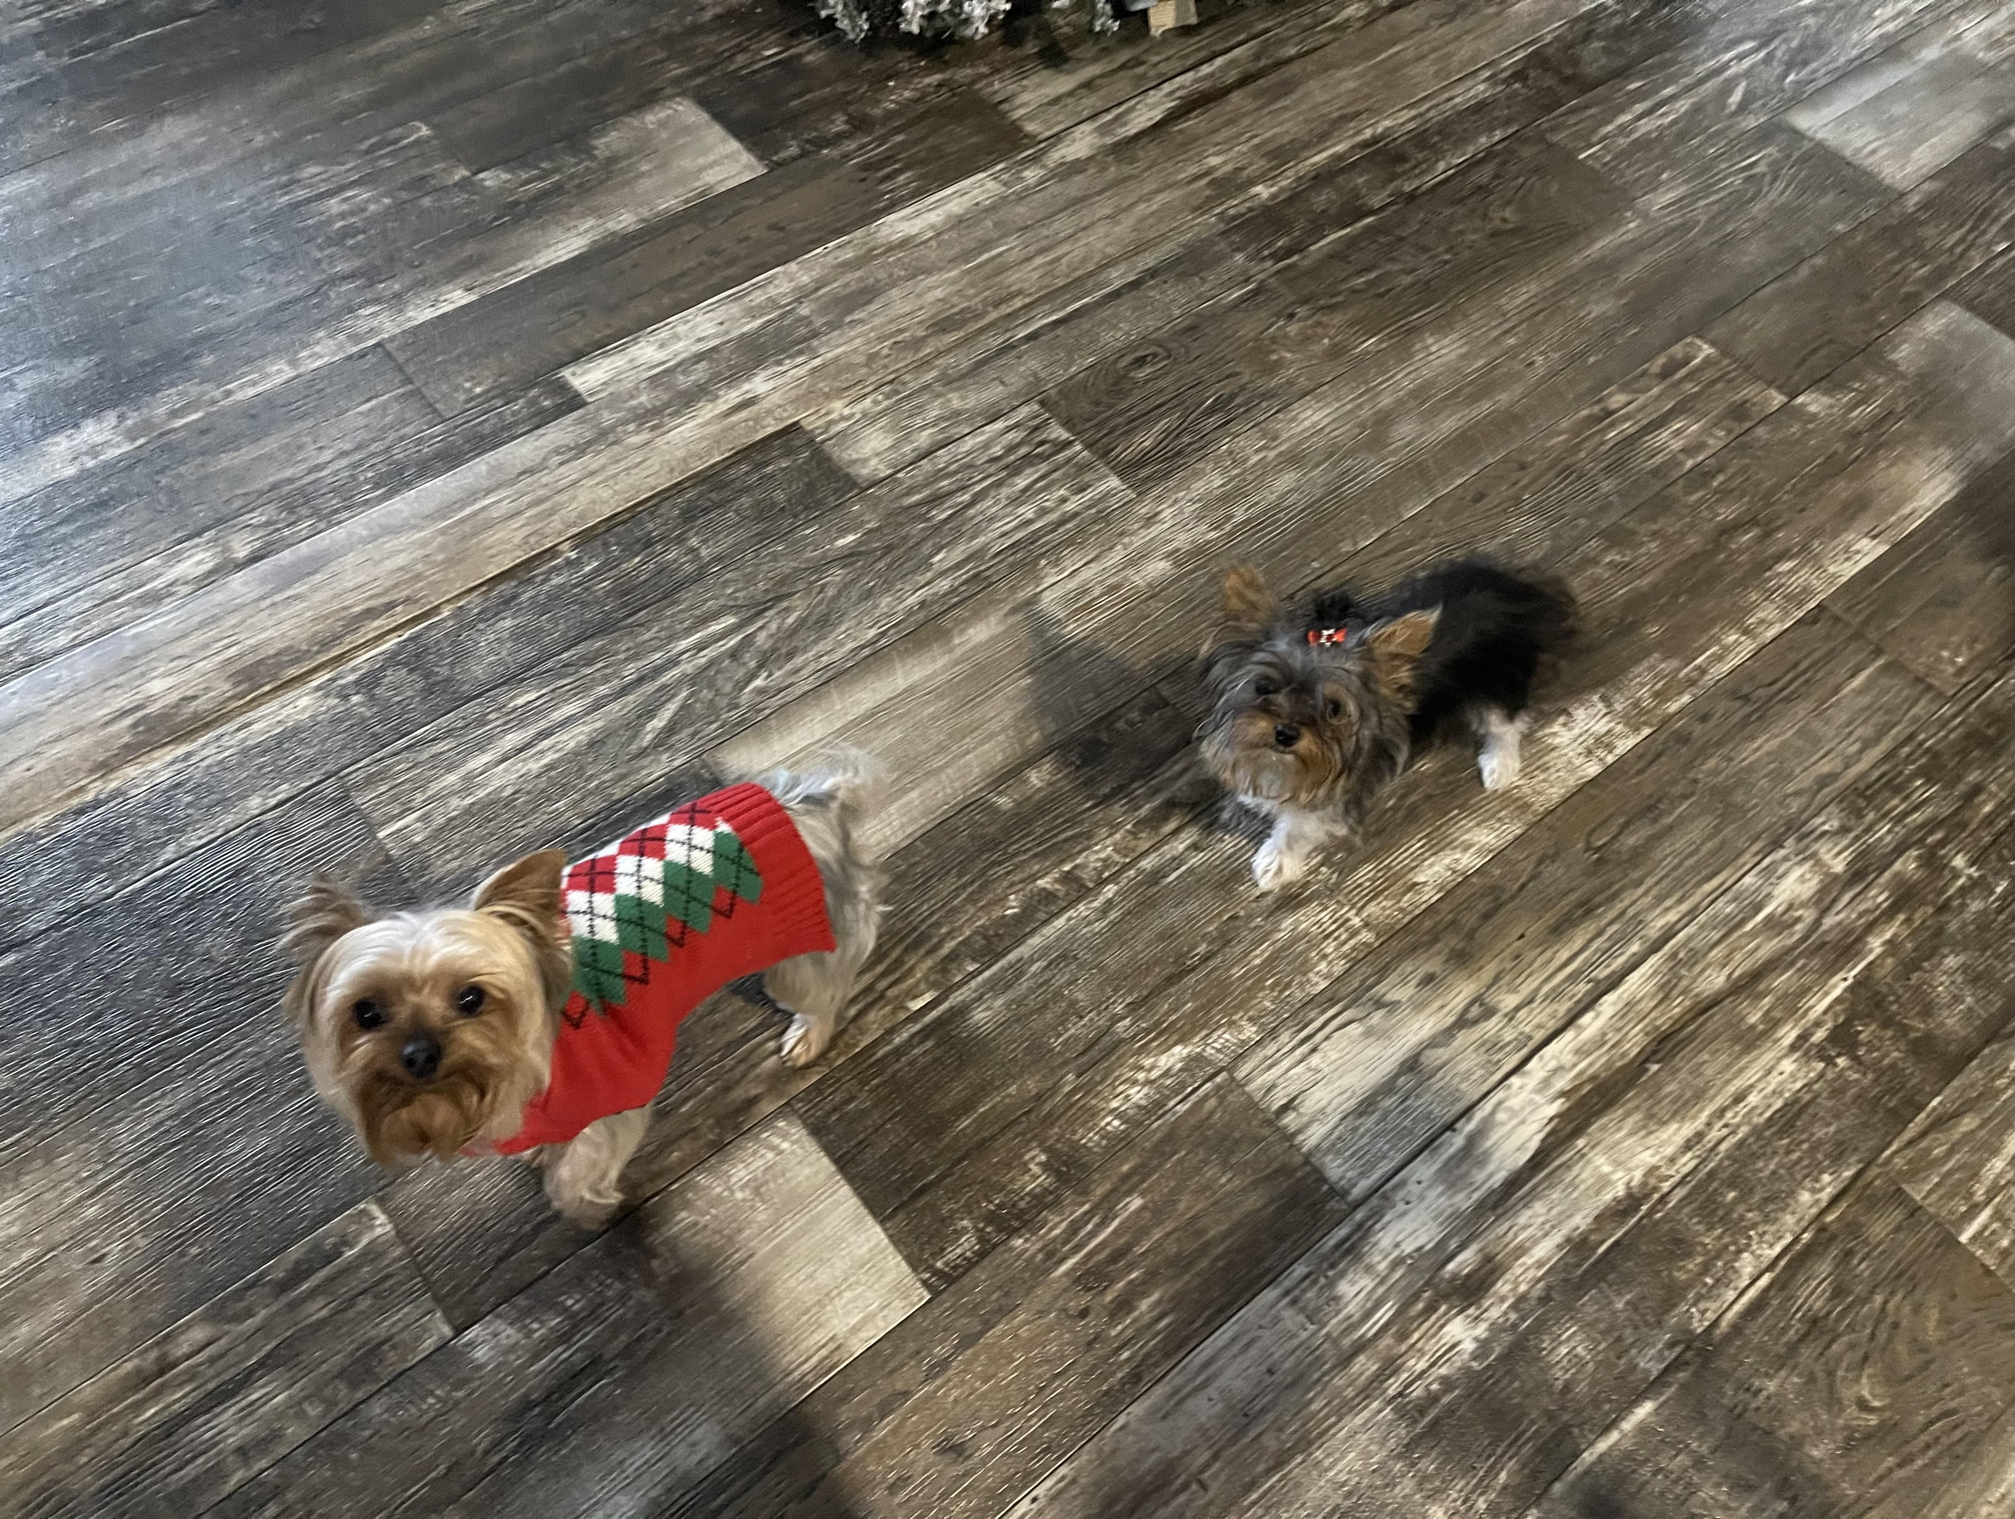

Honorary Teaching Assistants: Fiona, Bandit, and China
China
Bandit Fiona

Slide 7
Class TA
The TA is your point of contact for everything course-related
Students must email the TA first
Check the Syllabus Course Calendar and Other Information Before Contacting the TA.

Slide 8
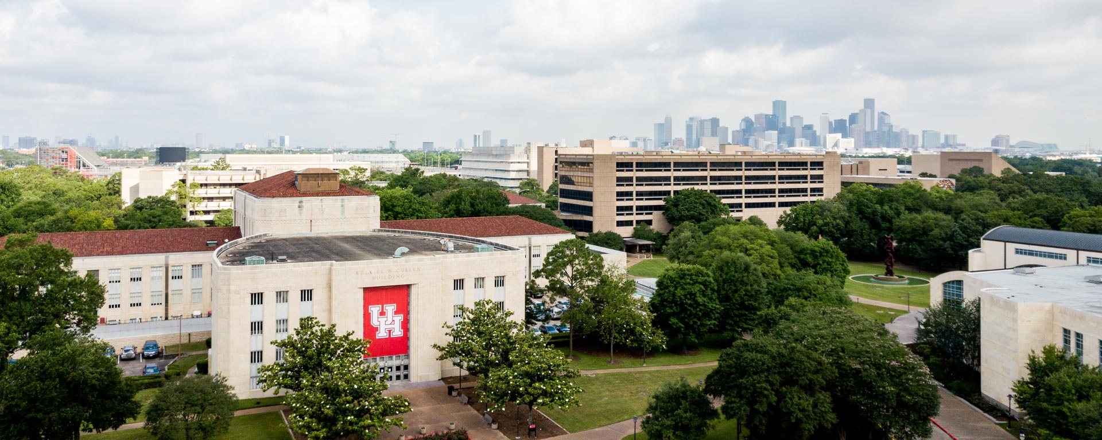

Mental Health
Counseling and Psychological Services
http://www.uh.edu/caps
(713) 743-5454
Let’s Talk Program
(no appointment necessary): http://www.uh.edu/caps/outreach/lets_talk.html

Slide 9
Required Texts
The Syllabus (This is the most important document in the course. Students must keep up to date with the syllabus. If changes need to be made, the professor or your TA will inform students. )
Geringer - International Business (3rd edition) with Connect Plus.
Some topics require additional readings and videos. Those readings and videos will be located in the appropriate topic folder

Slide 10
Recommended Readings
Each student should acquire a copy of the classic book on writing style, The Elements of Style by William Strunk and E.B. White. This book will help all students learn how to write effectively for all writing inside and outside of college.
Anyone involved in global business should be aware of business resources that provide information on industries, companies, markets, and more. Students should also pay close attention to media outlets for up to the minute stories that can have a dramatic impact on international businesses. The following library resources are highly recommended and should be used by each student when conducting research on the international business environment. These sources can be accessed via the UH library by using your CougarNet ID to log in. Click on the link (https://guides.lib.uh.edu/business) for more details about each of these sources.

Slide 11

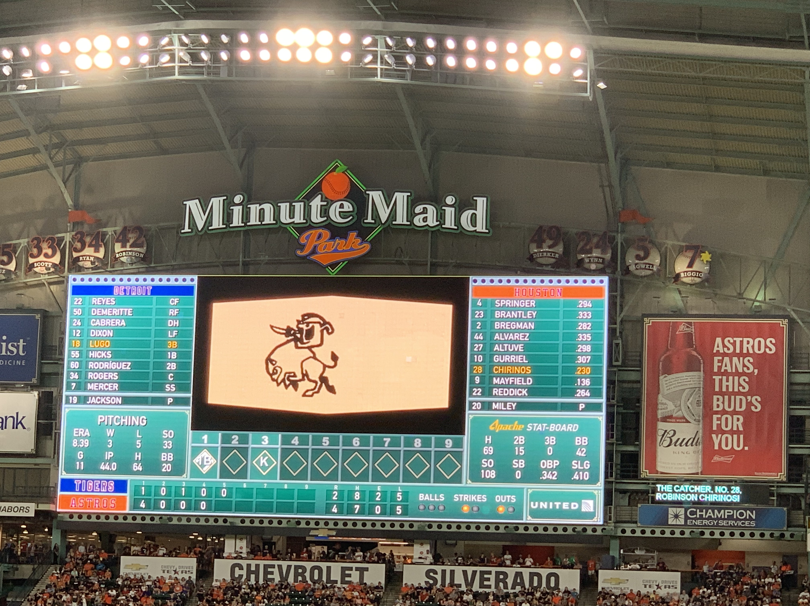
So, Let’s Get Started!!! Charge!!!

Slide 12

GOING THROUGH THE SYLLABUS
Course Assignments
Readings
Take notes on everything
Films
Readings
Lectures

Slide 13
Syllabus Assignments

